Slide 1
LED Volume meter
Group project by:
Abinash Satapathy
Saurav Panigrahi
Rishabh vallecha

Slide 2
Description
VU Meter or Volume Meter is very popular and fun project in Electronics. We can consider the Volume Meter as an Equalizer, which is present in the Music systems. In which we can see the dancing of LEDs according to the music, if music is loud then equalizer go to its peak and more LEDs will glow, and if music is low then lesser number of LEDs shall glow. Volume Meter (VU) is an indicator or representation of the intensity of sound level over LEDs and can also serve as a volume measurement device.

Slide 3
Two Content Layout with SmartArt
Circuit Connections
Code upload
Testing
Circuit
Code
Test

Slide 4
Code:
int i=0; int value1=0;
void setup() { for(i=3;i<11;i++) pinMode(i, OUTPUT); }
void loop() { int value=analogRead(A5); value/=10; for(i=3;i<=value;i++) digitalWrite(i, HIGH); for(i=value+1;i<=10;i++) digitalWrite(i, LOW); }

Slide 5
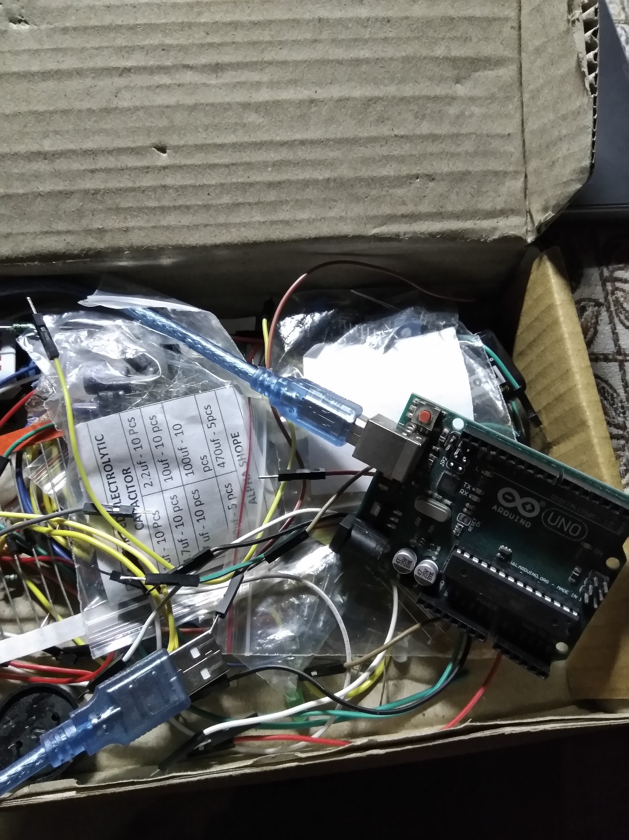

Slide 6
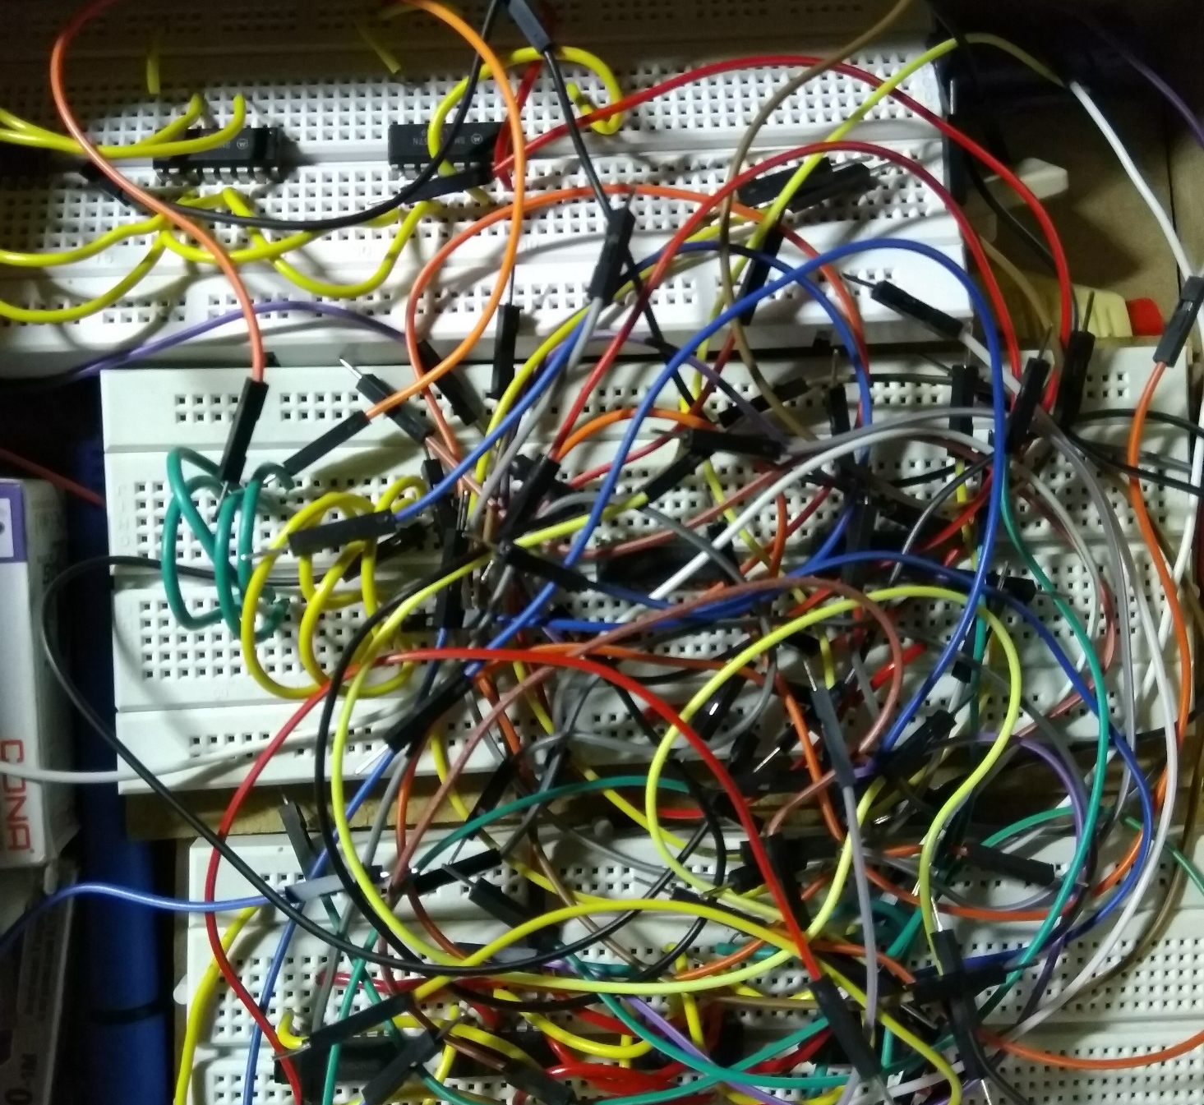
Connection try
Setting up breadboard connections

Slide 7
Thank you

